Slide 1
FUNCTION POINTS
A function point is a unit of measurement used to express the size and complexity of a software system.
Function points measure the functionality of a software system from a user’s perspective, focusing on the inputs, outputs, inquiries and data storage

Slide 2
Why Use Function Points?
To measure software size in terms of user functionality.
To estimate development effort, resources, and costs.
To compare productivity across projects or teams.
To assess maintenance complexity or ongoing support requirements.

Slide 3
Library Management system
Add books
Search books
Borrow
Return Book
Display book list
Inputs (eg. User inputs,data entry)
Outputs(e.g. reports, screens)
Inquiries (e,g.Searches,queries)
Internal Logical Files(e.g. databases,datastructures
External Interfaces Files(e.g, Integration with other systems)

Slide 4
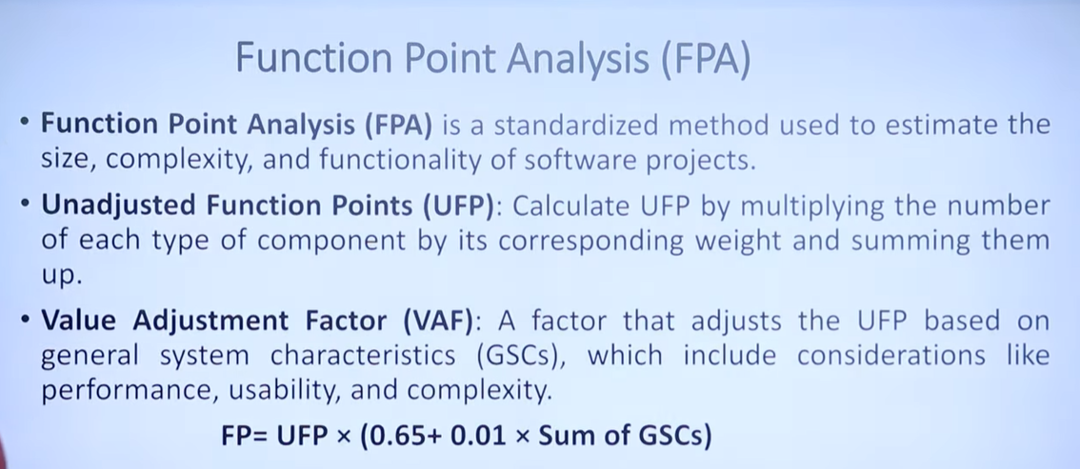
https://www.youtube.com/watch?v=7xBcVtjmGwM

Slide 5
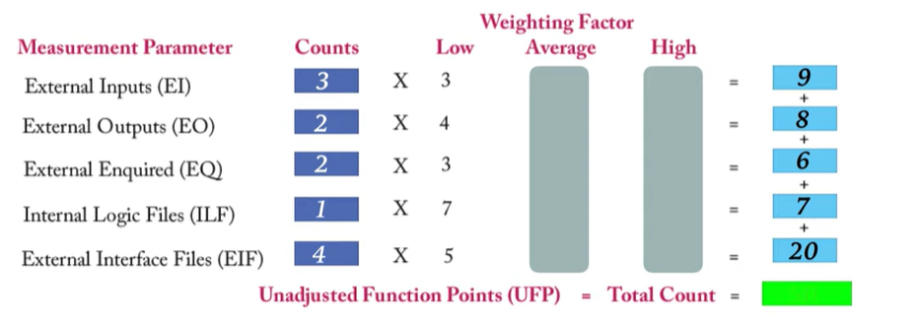

Slide 6
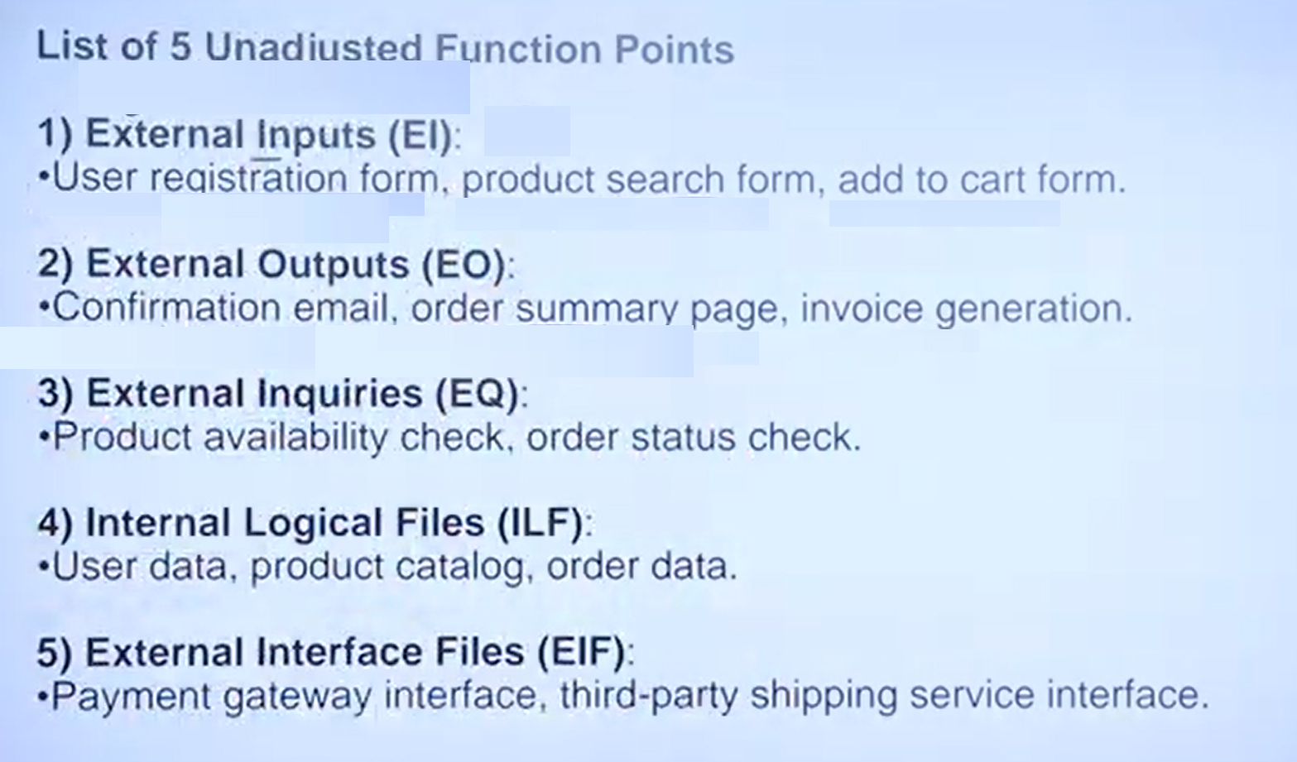

Slide 7
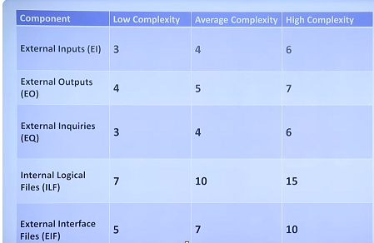

Slide 8
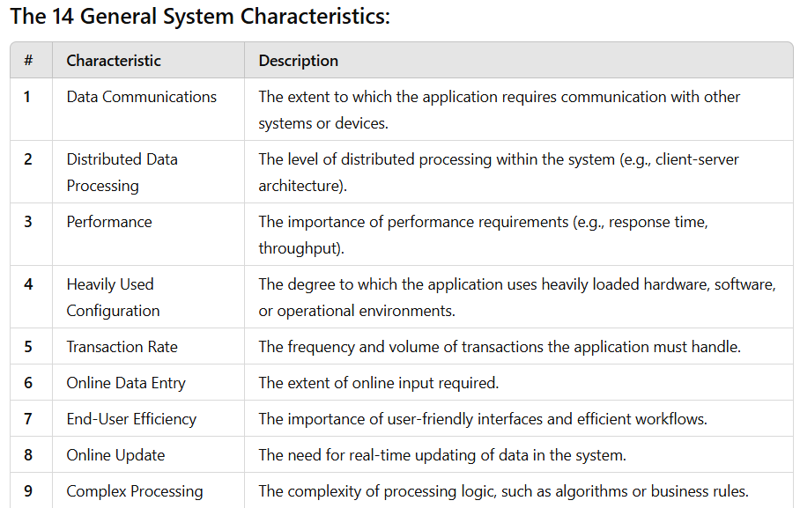
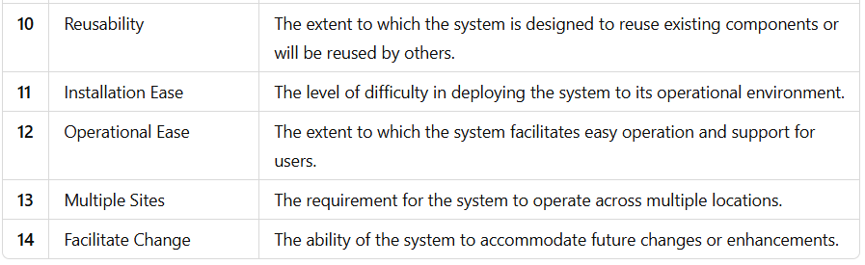
Each GSC is rated on a scale from 0 (no impact) to 5 (strong influence), and their sum contributes to the Value Adjustment Factor (VAF).

Slide 9
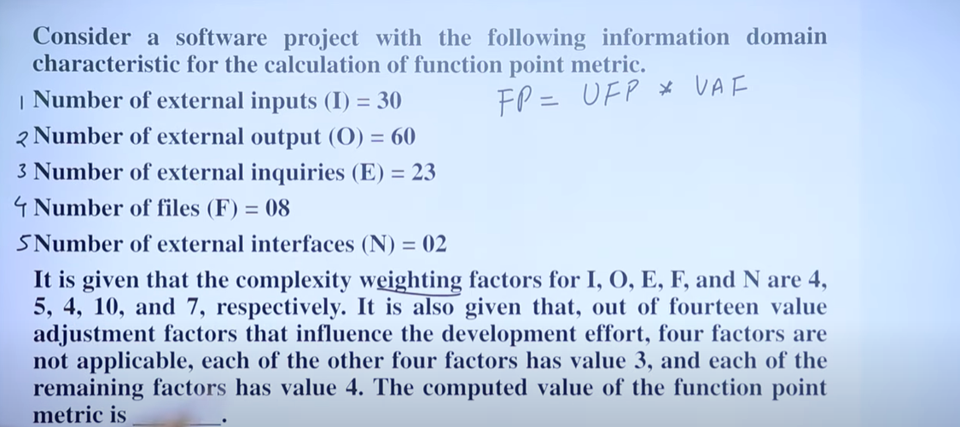
?
https://www.youtube.com/watch?v=bKwvzXQKBRo

Slide 10
